Slide 1



Product Management Bootcamp
For Everyone
Instructor-Led
Onsite or Remote
~6 Hours
Overview: Product management is the intersection of design, engineering, and business. Product managers are responsible for the development of everyday products that consumers and businesses use. They also innovate on features by engaging with the customers’ experience. This one-day bootcamp will take students through every aspect of the product development process to give them tangible deliverables that showcase their learning.
Learner Objectives:
Convey the role that digital products play in our everyday lives.
Explain the role and career trajectory of product managers.
Explain the industry-standard product develop process, the different stakeholders in each phase, and the goals of a PM in each phase.
Develop problem statements and hypotheses in business scenarios.
Apply best practices when creating questions for user interviews.
Conduct user interviews to validate hypotheses and gain insight into the customer experience.
Translate hypotheses to features within a product.
Utilize affinity mapping methods to validate findings in a real-world business problem.
Define the methodologies for evaluating customer experiences when picking the appropriate MVP.

Slide 2
Program Schedule
Day 1
10–10:15 a.m. | Welcome and Warm-Up
10:15–11:15 a.m. | Product and Product Managers
11:15 a.m.–12:15 p.m. | Foundational Market Research
12:15–1:00 p.m. | Activity: User Interviews + Share Out
1:00–2:00 p.m. | Lunch
2:00–3:00 p.m. | Analyzing Data
3:00–4:00 p.m. | Choosing the Right MVP
4:00–4:30 p.m. | Bring It Home

Slide 3
Product Management Bootcamp
General Assembly

Slide 4
What is General Assembly?
Notes:
General Assembly was founded in NYC 2011 as a coworking hub for innovators and entrepreneurs.
When our members were asked to share their expertise with one another through impromptu classes and workshops, the potential and power of peer-to-peer mentorship emerged.
We now offer more than 25 courses online and at 20+ campuses around the world from New York, to London, to Sydney and Singapore. We also work with businesses and have trained more than 40 of the Fortune 100 companies!
We’re most proud of our 70,000 full-time, part-time, and self-led alumni, as well as the 600,000 alumni of our workshops and bootcamps — all of whom were taught by active industry professionals.
Our curricula are developed in collaboration with our global business partners to ensure they meet industry demand.

Slide 5
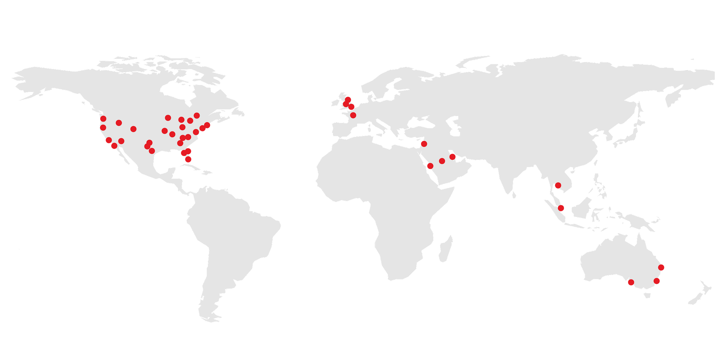
General Assembly is a pioneer in education and career transformation, specializing in today's most in-demand skills. We foster a flourishing community of professionals pursuing careers they love.
‹#› | © 2020 General Assembly
Notes:
So, who are we and why are you here? General Assembly — “GA” — is a global education institution that specializes in the most in-demand skills across data, design, technology, and business.
We offer classes, workshops, and courses in web development, design, digital marketing, data science, and business with a range of commitment options.
As part of helping individuals like yourselves acquire new skills and/or transition into a new career, we also work with a global network of employers as a source of talent. More than 9,000 of our Immersive graduates have been hired into tech careers!
TALKING POINTS:
General Assembly was founded in NYC 2011 as a coworking hub for innovators and entrepreneurs.
When our members were asked to share their expertise with one another through impromptu classes and workshops, the potential and power of peer-to-peer mentorship emerged.
We now offer courses online and at 30+ campuses around the world. We also work with businesses and have trained more than 40 of the Fortune 100 companies!
We’re most proud of our 70,000+ part- and full-time alumni, as well as the 500,000 alumni of our workshops and bootcamps — all of whom were taught by active industry professionals.
Our curricula are developed in collaboration with our expert network to emphasize real-world relevance and meet evolving employer demands.

Slide 6




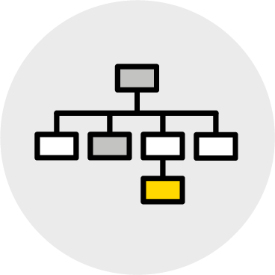

What We Teach
Coding
UX & Design
Data
Marketing
Business
Career Development
‹#› | © 2020 General Assembly

Slide 7

Meet Your Instructors <Bio Slide Optional>
Customize It!
{Your Name}
Title, Current Positions
{Bio Info}
{Insert picture}
Notes:
Purpose: Introduce yourself!

Slide 8

Getting to Know You
10 minutes
Customize It!
Introduce yourself to the class!
Please include:
Your name and what you do.
Why you’re taking this class.
Your favorite childhood cartoon.
Notes:
Teaching Tips:
Give everyone in the class a chance to introduce themselves.
Ask them to share their name, why they’re taking this class, and what they want to learn.
Ask them to share a fun fact about themselves to lighten the mood.
For remote classrooms:
Have students popcorn to each other once they answer to encourage them to get engaged.
You can write this in the Slack channel/Zoom chat and have students thread their responses.
Customize It
Add a different “fun fact” that students should share (e.g., favorite food, dream vacation spot, etc.).

Slide 9
Our Working Agreement
At GA, we create norms for how we’ll work together throughout the workshop.
Check out these working norms. Is there anything else we should add to the list?
Be Present.
Contribute Constructively.
Work Hard.
Ask Questions.
Be Supportive.
Talk to Us.
Notes:
Talking Points:
Working norms for the classroom are important to us at GA. They help us ensure that everyone is comfortable in the classroom and we’re helping you get the most out of the class.
Teaching Tips:
Run down each item.
Ask: Does anyone want to add anything to this list?
Customize It!
Switch out any of these working norms with ones that are important to you.

Slide 10
Products and Product Managers
Product Management Bootcamp
Products and Product Managers
Foundational Market Research
Analyzing Data
Choosing the Right MVP
Notes:
Duration: 90 minutes

Slide 11
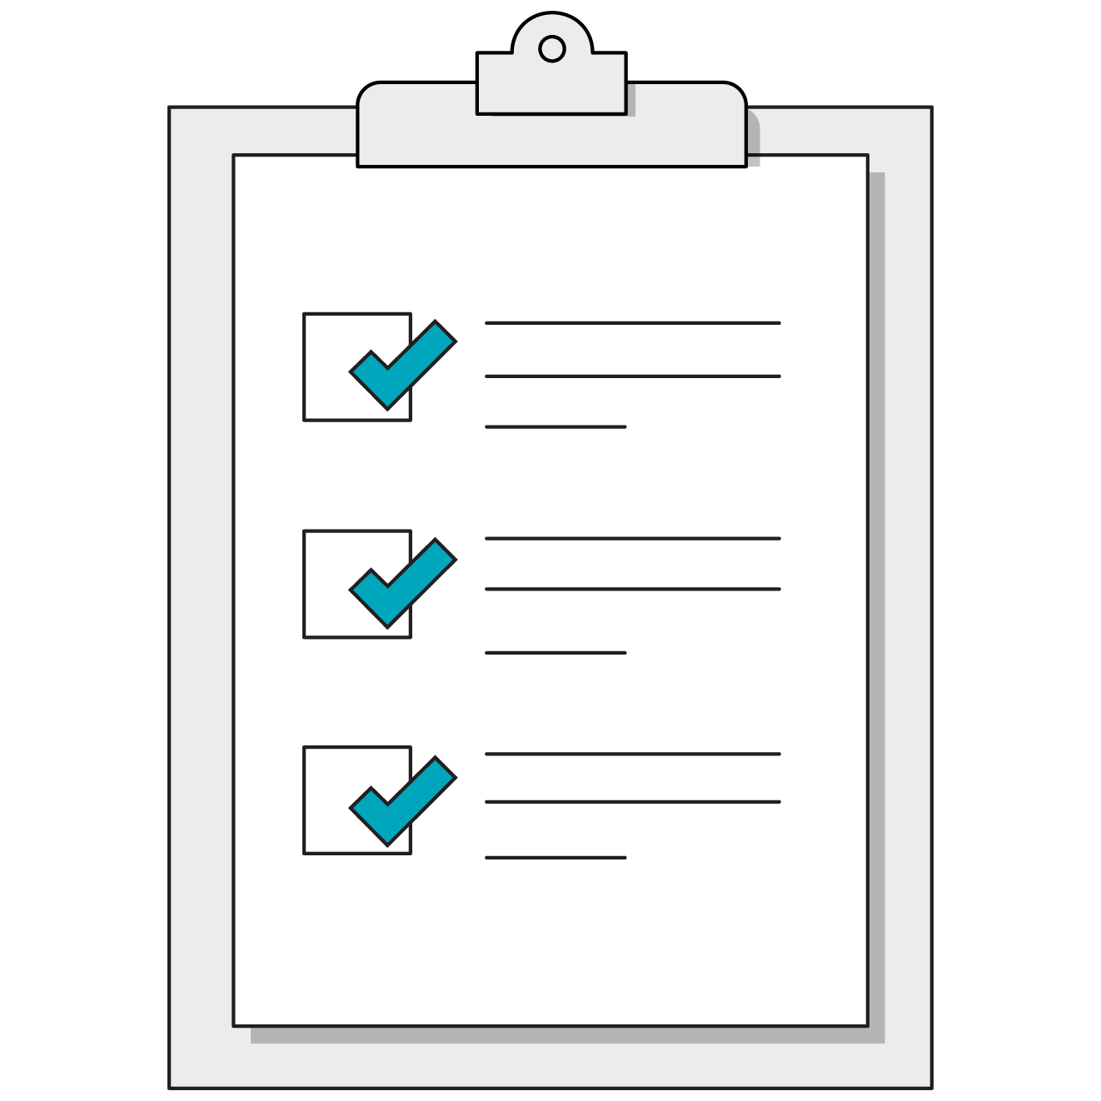
What’s Coming
Convey the role that digital products play in our everyday lives.
Explain the role and career trajectory of product managers.
Explain the industry-standard product development process, the different stakeholders in each phase, and the goals of a PM in each phase.
‹#› | © 2021 General Assembly
Notes:
Purpose: Highlight the learning objectives that we’ll tackle in this section.

Slide 12
Which of These Are Products?
Trivia!
A. Software that stores and protects customer data.
B. An internal new hire onboarding application.
C. A candy bar.
D. A newspaper.
E. All of the above.
Notes:
Purpose: Knowledge checkpoint to engage students.
Teaching Tips:
Physical classroom: Have students shout out answers.
Virtual classroom: Have students utilize the chat to submit answers.

Slide 13
Which of These Are Products?
Trivia!
A. Software that stores and protects customer data.
B. An internal new hire onboarding application.
C. A candy bar.
D. A newspaper.
E. All of the above.
Notes:
Talking Points:
Answer: All of the above.

Slide 14

What Is a Product?
A product is a solution to a problem experienced by multiple people.
A great product gels at the intersection of business, technology, and design.
DESIGN
BUSINESS
TECHNOLOGY
Notes:
Purpose: Conceptualizing how a product brings together design, engineering, and business teams.
Talking Points:
“Product” is a broad term that can mean software, physical goods, consulting services, a training course — anything that people buy and sell.
Products work when there’s a balance of technology, business, and design.
You’ll see a lot of these Venn diagrams throughout this workshop.

Slide 15
What Makes It Great?
5 minutes
Think about a product you love.
With your partner, discuss what makes that product great in terms of:
Business: What problem does it solve?
Technology: How does it solve the problem?
Design: How usable is it?
DESIGN
BUSINESS
TECHNOLOGY
Notes:
Purpose: Give students an opportunity to talk about a product they love and why it’s a good product.
Talking Points:
Think of a product you love. It doesn’t have to be anything fancy, just something you love to use.
Partner up with the person next to you.
You should each share your product and talk about why it’s so great.
In particular, think in the context of business, tech, and design. This is how PMs think, so it’s good to get in the habit!
Teaching Tips:
See if a few students want to share their products.

Slide 16
What Is Product Management?
Figuring out what products to make, ensuring they get made, and reporting back on how users respond to them.
Delivering a differentiated product to market that addresses a need and represents a viable business opportunity.
Guiding every step of a product’s life cycle — from development to positioning and pricing — by focusing on the product and its customers.
Articulating what a winning product looks like, rallying the team to build it, and iterating on it until they get it right.
Notes:
Purpose: Defining product management.
Talking Points:
What about product management?
Here are a few definitions of the discipline.
Teaching Tips:
Read out one or two that you like in particular.

Slide 17
Right in the Center of Everything
PRODUCT MANAGEMENT
CHANNEL PARTNERS
SALES
MARKETING
SUPPORT
FINANCE
LEGAL
M&A
SOLUTION PARTNERS
CUSTOMERS
DEVELOPMENT
OPERATIONS
SUPPLIERS
Internal
External
Notes:
Purpose: Define the stakeholders in product management and who they work with.
Talking Points:
The product management team is responsible for working with almost all internal groups and the external ecosystem to ensure products are great.
Managing trade-offs between these groups can be a challenge and is a big part of what makes product management so influential and fun.

Slide 18
What Is a Product Manager?
A product manager is…
A product manager is not…
A big-picture thinker
Detail-oriented
An expert on the market
The voice of customers
A leader
A jack of all trades
Diplomatic
A project manager
A developer
Customer support
The scapegoat
The boss
An order-taker
Notes:
Purpose: What a product manager is and isn’t.
Talking Points:
Roles and responsibilities vary based on the actual company and other members of the product team, but here are some key qualities.

Slide 19
Managers, and Marketers, and Owners — Oh My!
Product Manager
Strategic; focuses on a product’s vision, market, users, and company objectives.
Product Owner
Tactical; translates strategy into actionable tasks, ensuring that tasks are completed and managing the costs of development.
Product Marketer
Strategic; owns the go-to-market strategy and how the product is positioned to customers.
Project Manager
Tactical; creates a structured plan with well-defined deadlines and goals to ensure the project stays on schedule.
Notes:
Product: Differentiating the different roles in product.
Talking Points:
There are lots of jobs with the word “product” in their title.
Has anyone come across any of these job titles?
Does anyone need clarity on what a product manager does compared to these other roles?
Teaching Tips:
Note: You can mention that a product owner often appears in Agile or Scrum environments.

Slide 20
Career Pathways in Product Management
Executive influencer responsible for large initiatives and building the most value for the business.
Responsible for the strategy, roadmap, and feature definition of a product.
Director of PM role without the people management responsibility
Product Manager
Principal Product Manager
VP of Product
Associate Product Manager
Senior Product Manager
Director of Product
Chief Product Officer
Entry-level position, usually a mentorship and the start of a PM’s career.
Manages high-value products and acts as the liaison between PM team and business leaders.
Reports to CEO and is responsible for all product activities inside an organization.
Articulates a clear vision for the future of the product, communicates with customers, and prioritizes/defines features to achieve business goals.
Notes:
Purpose: Define the different career pathways in product management.
Talking Points:
This timeline breaks down the hierarchy of roles in product management.
Please keep in mind that these roles and responsibilities can vary between organizations.
Another common misconception with working in product is that there is single path into getting the role you want. There are a variety of different avenues.
Teaching Tips:
The instructor should share their career trajectory into product management as well as helpful tips to keep in mind when pursuing a role in product.

Slide 21

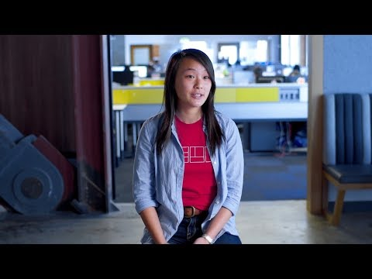
PM Life at Yelp
5 minutes
Let’s get a behind-the-scenes look at a day in the life of Brittany Cheng, a PM at Yelp.
As you watch, jot down:
What stakeholders does she work with?
What size of tasks does she work on?
What does she value about the role?
Source: YouTube
Notes:
Talking Points:
Let’s start to get a feel for the actual day-to-day activities of a PM.
Jot down notes during the video.
We’ll discuss a bit when it’s done.
Teaching Tips:
Other examples:
Soti Incorporated — based in Canada
Google — PMs at Google
Customize It!
Share your own schedule, the schedule of a team member, or another example — anything that highlights a day in the life of a PM.

Slide 22
It All Boils Down To…
Managing Stakeholders.
Being Data-Driven.
Staying Customer- Focused.
Notes:
Purpose: Summarize the core responsibilities of a product manager
Talking Points:
As we’ve seen, PM is a multi-faceted role.
But you can sum it all up with these three things.

Slide 23






The Product Squad
The Usual Suspects
Engineers
Designers
Product Manager
Squads might also include:
Scrum Master
Business Analyst
Project Manager
Notes:
Purpose: Outlining the product team.
Talking Points:
Let’s start with stakeholder management. We’ve already touched on it a bit.
First, you have the PM squad: the people you’ll work with all of the time.
Here’s a typical squad.

Slide 24

Debate and Defend
5 minutes
The product manager is the conductor of the orchestra.
The product manager is the CEO of their product.
Notes:
Talking Points:
Based on what we’ve talked about and what you may already know about PMs, which of these is a better representation of the job? Why?
Teaching Tips:
Have a few students shout out their answers.
If no one volunteers, explain that, at GA, we think of PMs as the conductor, not the CEO.
For remote classrooms:
Instruct students to come off mute to share their responses.

Slide 25
The Product Development Process
1
2
3
4
5
6
7
Conceive
Plan
Develop
Launch
Iterate
Steady
State
Maintain
or Kill
Notes:
Purpose: Outline the product development process.
Talking Points:
The product life cycle looks something like this.
Today, we’ll do a whirlwind tour of this process as we conceive and plan for your project, develop and launch it, and iterate on it as it progresses through its life cycle.

Slide 26
The Product Development Process
Conceive | Look for customer problems or complaints.
Plan | Conduct research to assess the validity of your hypothesis and better understand your customers.
Develop | Determine the priority, scope, and requirements of features to be built.
Launch | Support marketing and sales in positioning the product for customers.
Iterate | Gather data to determine what aspects of the product are successful.
Steady State | Analyze and optimize ROI.
Maintain or Kill | Decide if it’s financially viable to maintain a product or sunset it and move on.
Notes:
Purpose: Outline the responsibilities of a PM throughout the process.
Talking Points:
Here’s a quick overview of the PM’s responsibilities at each phase of the process.

Slide 27
Process Debrief
Now that we’ve seen the product development process…
Which phases stand out to you? Why?
Which phases seem the most complicated?
Which phases do you have the most questions about?
Notes:
Purpose: Give students the opportunity to gauge their understanding of the product development process.

Slide 28



How Work Gets Done
Waterfall
All at once
Agile
Iterative
Lean
Deliver value quickly
Notes:
Purpose: A brief overview of the different product development frameworks.
Teaching Tips:
Give some more background about Agile in the context of waterfall.
Note: Don’t spend too much time explaining this, as there will be an opportunity to examine it further.
Talking Points:
Waterfall
Waterfall is sort of “the way things have always been:” It’s a sequential process where each stage of development is completed before moving onto the next (like a waterfall). It typically involves gathering requirements, followed by design, development, delivery, etc.
Waterfall may still be used for hardware or when you need to launch a version of your product that’s manufactured at scale.
Agile
On the other hand, you have Agile. In its simplest form, Agile is an iterative process of development. Instead of building the whole product, you build the smallest possible useful part and give it to users who then tell you what is right and what is wrong.
Agile primarily focuses on software development and shares some overlaps with lean, but companies are looking for ways to use it for other products.
Delivering working software via flexible, self-improving systems is the focus here.
Lean
The lean process focuses on creating a minimum viable product (MVP) and ensuring that there is a product/market fit.
Lean tells you to optimize the end-to-end process that creates value for your customer, from the initial idea to collecting payment.
Lean shares common values with Agile, and they can be used together.

Slide 29
Waterfall: Great If…
Agile: Great If…
Market conditions are stable and predictable.
Requirements are clear at the outset and remain clear.
Late changes are expensive or impossible.
Mistakes are catastrophic.
Customer preferences change frequently.
Customer collaboration and feedback is easy.
Scope and specifications might change.
Late changes are manageable.
Healthcare, government, sales teams
Software teams, IT, marketing, SaaS businesses
Notes:
Purpose: Describe the key differences between the waterfall and Agile frameworks.
Teaching Tips:
Recap the previous activity: Which scenarios use waterfall or Agile? Why?

Slide 30
Foundational Market Research
Product Management Bootcamp
Products and Product Managers
Foundational Market Research
Analyzing Data
Choosing the Right MVP
Notes:
Duration: 60 minutes

Slide 31
What’s Coming
Develop problem statements and hypotheses in business scenarios.
Apply best practices when creating questions for user interviews.
Conduct user interviews to validate hypotheses and gain insight into the customer experience.
‹#› | © 2021 General Assembly
Notes:
Purpose: Highlight the learning objectives that we’ll tackle in this section.

Slide 32
Introducing the Project
Activity + Debrief Guide
Overview
Before diving into the core materials of the day, introduce the group project, which will act as a narrative thread that ties all the in-class exercises together. Students will choose from the scenarios here and use the product management worksheet to document their process throughout the day.
Activity
The following activity slide provides time for you to...
Divide the class into groups (max four people/group).
Assign or ask each group to select their scenario.
Introduce the worksheet that they will be completing throughout the day.

Slide 33

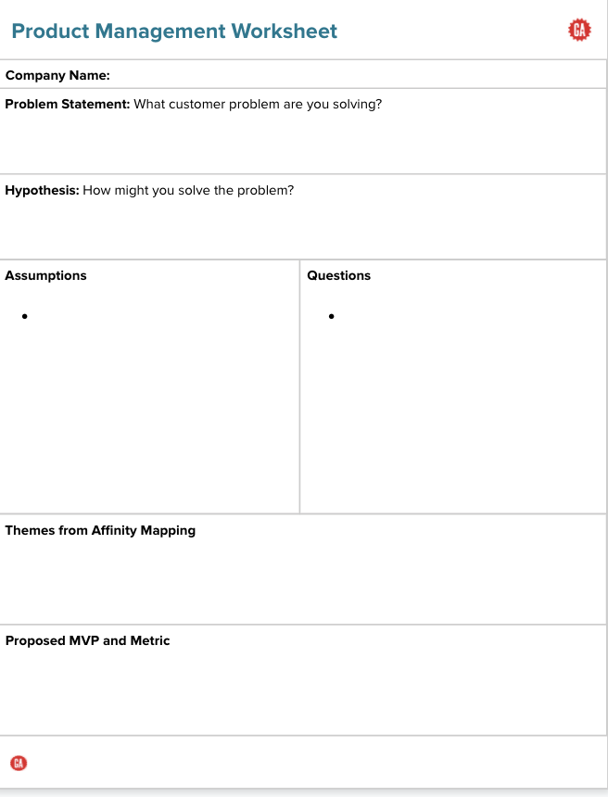
Your Challenge
8 minutes
Product Management Worksheet
Throughout the day, you’ll apply some of the most essential product management skills using fictional companies with real problems.
Take a few minutes to review the worksheet. This will serve as the brief you’ll be putting together to collect data for your company.
As a group, review the assigned scenario. Start sharing your understanding of what the problem is and some ideas about how it can be solved.
Notes:
Purpose: Introduce the in-class project.
Talking Points:
General Assembly is all about providing hands-on learning opportunities.
This project will give you an opportunity to practice and apply what you learn in each section, share your plans, and get feedback from each other and me.
TEACHING TIPS:
Instructors/IA should assign group students and scenarios to those groups.
Send the link to the scenario prompts out to the class so they can review and make a selection.
Link to Product Management Worksheet: https://bit.ly/2KV8gCt

Slide 34
In-Class Project
WalkMe | The business: Dog Walking Service Mobile App The problem: You’ve noticed from talking to friends and neighbors that they have trouble finding and retaining reliable, high-quality dog walkers. You think there might be an opportunity to create an app that matches dog owners with reliable dog walkers. Your goal: Understand the problems pet owners have with existing dog-walking options and design an MVP to test your key assumptions.
Bake It All | The business: Home Baking Supplies Website The problem: One tasty byproduct of the recent pandemic is the huge increase in the popularity of home baking. After several months of explosive growth at Bakeitall.com, sales of cake decorating supplies have plummeted. They’re looking to you to figure out why. Your goal: Understand why customers have stopped buying your cake-decorating supplies and propose an MVP to address their concerns.
NextGen Analytics | The business: Enterprise Analytics Tool The problem: You’re a product manager at NextGen Analytics, a fast-growing SaaS company in a highly competitive market. You have one of the hottest products going, but, despite thousands of downloads of your free trial version, you’re having trouble getting users convert to the paid version. Your goal: Understand what is preventing customers from becoming paid subscribers and craft an MVP that will increase conversions.
StayHere | The business: Stayhere Vacation Rentals The problem: Stayhere is a scrappy startup in the online vacation rental marketplace. With large competitors like Airbnb, it is always looking for new ways to differentiate its offering. As a product manager looking to get noticed, you’ve identified auto rental as a new service that might be of interest for Stayhere users. Your goal: Determine if car rental is viable for Stayhere by understanding users’ needs and proposing an MVP to test your assumptions.

Slide 35

Why Do We Do Market Research?
To understand the reasons customers buy our product.
To discover factors that influence customer behavior.
To measure the size of the potential market.
To see how competitors approach common problems.
To identify opportunities to differentiate or innovate.
Notes:
Purpose: Briefly cover what market research entails.
Talking Points:
We’re lightly touching on market research here so you have some precursory knowledge. For the purposes of our projects, however, we’re assuming market research has already been done.

Slide 36
What Is Consumer Research?
Customer research involves frequent interactions and iterations with potential customers to build the best products.
Notes:
Purpose: Emphasize why customer research is important.
Talking Points:
Talking to customers can help prevent a lot of the issues businesses face.
While market research gathers data about entire markets, consumer research focuses on simple demographics of an existing or potential customer group (such as age, gender, or income level).

Slide 37

The Power of Listening
5 minutes
Customize it!
Business goal: A London-based design firm wanted to help Samsung understand why elderly people were reluctant to use smartphones.
The problem: Samsung thought that the elderly people weren’t using the phone because of digital fluency.
Results: The found that elderly people weren’t using phones because they were going straight to the manual, getting lost in the details, and becoming discouraged.
Notes:
Purpose: Articulate the importance of market research through a case study.
Source: http://specialprojects.studio/project/out-of-the-box/
Talking Points:
The goal of this example is to demonstrate that the issue isn’t always what you think. It takes listening to your users to understand what their problems actually are.
In 2009, consultants London-based design firm Special Projects were enlisted to help Samsung understand why elderly people were reluctant smartphone users (only 5% of elderly users were sending at least one text a day). Through user research, the team found that it wasn’t an individual’s age or digital fluency that hindered their smartphone experience, as it initially assumed. Instead, it was the out-of-the-box experience.
In a test where both an elderly user and a young user were given £100 to buy a phone, both had the same level of motivation and desire. But, while the young user went straight to trial and error to learn how the phone worked, the elderly user went straight to the manual, which overwhelmed and discouraged them before they even set up the phone. This is why Special Projects created a tactile manual where the phone components are placed within the book and users are guided through setup as they turn the pages.
Customize It!
Feel free to use a different example. The key is to help students to understand the importance of understanding consumers.

Slide 38


Problem Statements and Hypotheses
Focus your customer research on validating problem statements and hypotheses.
Problem Statements
Written from a customer perspective.
Hypotheses
Your expectation of customer behavior given a certain condition.
Notes:
Purpose: Talk about the difference between problem statements and hypotheses and how they tie into customer research.
Talking Points:
Customer research can give you a ton of data, which also means you can take it in a ton of different directions.
In our case, we’ll focus customer research around our problem statement and hypothesis.
The goal of customer research here is to validate these statements — i.e., make sure they reflect what customers actually think — so we can build the right product for them.

Slide 39

Problem Statements and Hypotheses
Problem Statement
I need a way to find and pay for a taxi when I need one because I usually don’t carry cash, and many taxis don’t accept cards.
Hypothesis
We believe that, by making it simple to pay, more riders will use our app to go where they want, when they want.
Notes:
Purpose: This is an opportunity to use Uber as example to analyze the differences between a problem statement and a hypothesis.
Talking Points:
Here’s a problem statement and hypothesis for Uber.
This is something the company might instinctively think about its customers or have noticed from data and behavior. But it needs to be proven and validated via research.

Slide 40
Writing Problem Statements and Hypotheses
8 minutes
Using this template, draft a problem statement for your project.
Problem Statement
Define the problem your users are facing from their perspective.
I need a way to ___________ _______users’ need_________,
because ________________
_________insight__________.
Directions
As a team, brainstorm the different problems customers face.
Prioritize them, then write a problem statement for the top problem.
Deliverable: A prioritized list and problem statement. Keep your results.
Notes:
Purpose: An exercise to give students a chance to write a problem statement for their projects.
Talking Points:
This is one of the most important parts of your project. It will set the whole thing up for success and frame a lot of your work to come.
Take a stab at writing these based on what you already know about your customers and ideas you might have for solving their problems.
Teaching Tips:
Note: Have some students share what they wrote to get a sense of people’s work so far.
For remote classrooms:
Set up breakout rooms for student pairs/groups. Screenshot the slide and post it in the Slack channel before opening the rooms.
At the 60-second mark, send a message to all rooms: “Start to wrap up your discussions. Rooms will close in one minute!”
Move around from breakout room to breakout room to “walk around the classroom.”

Slide 41
Writing Problem Statements and Hypotheses (Cont.)
8 minutes
Using this template, draft a hypothesis for your project.
Hypothesis
What can you do to address their problem?
We believe that by ________
__doing or creating something__,
then ___________________
________outcome_________.
Directions
As a team, craft a hypothesis based on the problem statement you've written.
Then, we’ll walk through your hypothesis.
Deliverable: A hypothesis that is specific, testable, and measurable.
Notes:
Purpose: An exercise to give students a chance to write a hypothesis for their projects.
Talking Points:
This is one of the most important parts of your project. It will set your project up for success and frame a lot of your work to come.
Take a stab at writing these based on what you already know about your customers and ideas you might have for solving their problems.
Teaching Tips:
Note: Have some students share what they wrote to get a sense of people’s work so far.
For remote classrooms:
Set up breakout rooms for student pairs/groups. Screenshot the slide and post it in the Slack channel before opening the rooms.
At the 60-second mark, send a message to all rooms: “Start to wrap up your discussions. Rooms will close in one minute!”
Move around from breakout room to breakout room to “walk around the classroom.”

Slide 42

Problem Statement/Hypothesis Share Out
10 minutes
Notes:
Purpose: Give each group an opportunity to share out its product/problem statement/hypothesis.
Teaching Tips:
Instruct student to use the product management worksheet to write out their hypotheses and problem statements.
Instructors should pick groups to share out their problem statements and hypotheses.
Instructors should be observing whether or not each group has a good understanding of how write a problem statement and hypothesis for its project.
Each group should have a problem statement and hypothesis following the guidelines in Slides 38–39.
Give them live feedback to ensure everyone is on the right track.
For Remote Instruction:
Have students come off mute to share.

Slide 43
Spot the Assumptions
Problem Statement
I need a way to find and pay for a taxi when I need one because I usually don’t carry cash, and many taxis don’t accept cards.
Hypothesis
We believe that, by making it simple to pay, more riders will use our app to go where they want, when they want.
Notes:
Purpose: Introduce learners to the concept of assumptions.
Talking Points:
What part of these statements are assumptions?

Slide 44
They’re All Assumptions!
Problem Statement
I need a way to find and pay for a taxi when I need one because I usually don’t carry cash, and many taxis don’t accept cards.
Hypothesis
We believe that, by making it simple to pay, more riders will use our app to go where they want, when they want.
Notes:
Talking Points:
Gotcha! The answer is all of the above. All of these are assumptions. It’s nothing fancier than that.

Slide 45
Research Goals
5 minutes
What do we need to understand about our users?
Problem Statement
I need a way to find and pay for a taxi when I need one because I usually don’t carry cash, and many taxis don’t accept cards.
Hypothesis
We believe that, by making it simple to pay, more riders will use our app to go where they want, when they want.
Notes:
Talking Points:
Remember how we said that we use research and interviews to validate our assumptions?
We already know that these statements are assumptions.
So let’s discuss. Imagine we work at Uber. Given these assumptions, what would we want to understand about our users?
Potential answers:
How they currently find and get taxis.
How they currently pay for taxis.
What’s difficult about that process.
What would “easy” look like in an ideal world.

Slide 46

Creating Interview Questions
10 minutes
For your product, write a list of 5–10 assumptions about your users and their problems.
Notes:
Purpose: Give students an opportunity to create their own assumptions based on the hypothesis they developed.
Talking Points:
Now that you know some best practices for asking questions, it’s time to write questions for your project.
To start, write the assumptions you need to validate.
Then, write the interview questions you would ask to validate those assumptions.
For remote classrooms:
For solo activities, you can choose to put people in group breakout rooms or allow students to work independently in the main session.

Slide 47
Everything is an assumption until you validate it.
Notes:
Talking Points:
By now, you should be an expert in this whole assumptions thing.
A key part of being a PM is realizing that everything you think you know about customers is an assumption until you validate it using research.

Slide 48
There Are Plenty of Options Out There
Qualitative
Quantitative
Interviews
Surveys
Focus groups
A/B testing
Diary studies
Product or website metrics
Usability testing
Customer support metrics
Notes:
Purpose: Introduce different methodologies of research.
Talking Points:
So, how do you actually do all of this customer research?
There are a number of options, both qualitative and quantitative.

Slide 49
There Are Plenty of Options Out There (Cont.)
Qualitative
Quantitative
Interviews
Surveys
Focus groups
A/B testing
Diary studies
Product or website metrics
Usability testing
Customer support metrics
Notes:
Purpose: Highlight the methodologies that are heavily used in the industry.
Talking Points:
Highlighted research types = best for this phase in the development process.
In this lesson, we’ll specifically focus on customer interviews because they’re important for the development process and can be incredibly illuminating.

Slide 50
Why Interviews?
Customer interviews should be designed to validate the assumptions you’re making about users.
Notes:
Talking Points:
We’ve said it once and we’ll say it again (and again and again throughout this course): You need to validate your assumptions about your users through research. That’s what customer interviews are for.

Slide 51
Choose the Better Question
Do you use free weights at the gym?
What type of equipment do you use at the gym?
Notes:
Talking Points:
Let’s refine a few of the questions you wrote by looking at some best practices for asking them.
Teaching Tips:
Have students shout out which one they think is better and explain why.

Slide 52
Choose the Better Question: Solution
Do you use free weights at the gym?
What type of equipment do you use at the gym?
Ask open-ended questions.
Notes:
Talking Points:
The question on the left is closed. It generates a yes/no answer that only gives you feedback about weights.
The question on the right leads to a lot more discussion about what happens at the gym.

Slide 53
Choose the Better Question
How many times did you go to the gym last month?
How often do you go to the gym?
Notes:
Talking Points:
Have students shout out which one they think is better and explain why.

Slide 54
Choose the Better Question: Solution
How many times did you go to the gym last month?
How often do you go to the gym?
Ask about specific instances.
Notes:
Talking Points:
Ask about specific instances, not generalities. When you ask someone how often they go to the gym, they might answer generally. “Five times a week” is what we’d all hope to answer for that. In reality, it might look much different. By focusing on what has already happened, you get a better sense of what people are actually doing.

Slide 55
Choose the Better Question
What type of exercise gives you the best workout?
Would you say that cardio is a better workout than weight lifting?
Notes:
Talking Points:
Have students shout out which one they think is better and explain why.

Slide 56
Choose the Better Question: Solution
What type of exercise gives you the best workout?
Would you say that cardio is a better workout than weight lifting?
Avoid leading questions.
Notes:
Talking Points:
The question on the right is leading — it already assumes that cardio is better than weight lifting. You’re boxing people into that answer.
The question on the left opens up their possible answers a lot more broadly.

Slide 57
Phrase Your Questions for Better Insights
More closed
More open-ended
Is or Does
When
Which
Who
Where
What
How
Why
Notes:
Purpose: Introduce how to write better interview questions.
Talking Points:
The way you phrase questions can help you gain better insights.
“What?”, “How?”, and “Why?” are more powerful open-ended questions that lead to better conversations.
“Is?”, “Does”, “When?”, “Which?”, “Who?”, and “Where?” are more closed and lead to yes/no or basic answers.

Slide 58
Questions That Lead to Conversations
Tell me more about…
Can you describe the last time you…
What do you mean by…
Am I right in thinking…
How did you feel the last time you…
Can you elaborate on…
How do you do that today?
Why was it that…
Can you help me understand more about…
How often does this occur?
Notes:
Talking Points:
Here are some more examples of how you might phrase questions to lead to conversations and more/better insights.

Slide 59


Creating Questions
8 minutes
Now that you’ve had a chance to create assumptions individually, you’ll come to together as a group to:
Step 1: Each group should create a list of 5–10 assumptions on which your group can agree.
Step 2: Create 5–10 interview questions based on those assumptions.
Step 3: As a group, review the questions to ensure that they meet the criteria of good interview questions.
Notes:
Purpose: Give students a chance to create their own user interview questions based on their assumptions .
Teaching Tips:
Instruct students to use the worksheet to write out their assumptions.
Remind students that they should be asking open-ended questions when creating questions.
For remote classrooms:
Set up breakout rooms for student pairs/groups. Screenshot the slide and post it in the Slack channel before opening the rooms.
At the 60-second mark, send a message to all rooms: “Start to wrap up your discussions. Rooms will close in one minute!”
Move around from breakout room to breakout room to “walk around the classroom.”

Slide 60
Conducting User Interviews
Activity + Debrief Guide
Overview
Help students write open-ended interview questions that enable them to better understand their projects. They’ll then conduct a user interview with a classmate and be interviewed in return.
Activities
Partner: Give student pairs 20 minutes to interview each other. If time allows, do one more round of pairings so that students can have a minimum of three interviewees.
Solo: Give students 15 minutes to debrief with their groups and synthesize their interview notes.

Slide 61

Interviewing Customers
30 minutes
Find a partner from another team.
10 minutes: Interview your partner as if they are your user using the questions you drafted. Take notes.
10 minutes: Switch so that the interviewee becomes the interviewer.
10 minutes: Summarize what you learned from the interviews and prepare to share with your team.
Notes:
Purpose: Students will be able to interview each other to get a feel of what it's like to interview customers.
Talking Points:
Don’t worry, we’re not just all talk. You have to do something with those questions.
Let’s practice interviewing customers using the questions you wrote.
In pairs, take six minutes to interview your partner. Then, take some time to get feedback on how you did.
Switch roles so you each get time for feedback and practice.
Teaching Tips:
Depending on the size of the class, no student should be a customer twice.
For remote classrooms:
Set up breakout rooms for student pairs/groups. Screenshot the slide and post it in the Slack channel before opening the rooms.
At the 60-second mark, send a message to all rooms: “Start to wrap up your discussions. Rooms will close in one minute!”
Move around from breakout room to breakout room to “walk around the classroom.”

Slide 62
Interview Debrief
15 minutes
Now that you all have had chance to interview your customers, come together as a group and discuss any insights gained from the interviews. Questions to consider:
Do you feel like you asked the right questions?
What might you change about the questions?
Do you feel the questions mapped well to your assumptions?
What do you think would be the next steps after interviewing?
Was there anything surprising?
Notes:
Purpose: Give students a chance to meet with their groups to talk through insights from their interviews.
Talking Points:
Now that you all have had a chance to talk to your customers and gain insight into their experience with your product, come together as a group a look through the customer feedback.
As you’re looking through the feedback, please keep in mind these questions. We’ll be coming back to share the insights from each group.
Elect one person from the group to share out.
For remote classrooms:
Set up breakout rooms for student pairs/groups. Screenshot the slide and post it in the Slack channel before opening the rooms.
At the 60-second mark, send a message to all rooms: “Start to wrap up your discussions. Rooms will close in one minute!”
Move around from breakout room to breakout room to “walk around the classroom.”

Slide 63

Lunch!
Notes:
Purpose: A break/lunch slide to show where we are on today’s agenda.
TEACHING TIPS:
Feel free to move this slide to a “pause” point that makes sense for your cohort.
Important: Recommend optional activities for students to complete during lunch time. For example:
Finishing user interviews
Partnering up for thought partnership for continued interview debriefs
Any additional reading you’d like to recommend, etc.
For remote classrooms:
Encourage students to stay in the Zoom room during lunch. This helps with networking, understanding attendee motivations, and building a shared sense of togetherness.

Slide 64
Analyzing Data
Product Management Bootcamp
Products and Product Managers
Foundational Market Research
Analyzing Data
Choosing the Right MVP
Notes:
Duration: 60 minutes

Slide 65
What’s Coming
Translate hypothesis to features within a product.
Utilize affinity mapping methods to validate findings in a real-world business problem.
‹#› | © 2021 General Assembly
Notes:
Purpose: Highlight the learning objectives that we’ll tackle in this section.

Slide 66

What Do We Do With All of Our Data?
Once you’ve gathered your research, it’s time to put it to work.
Look for themes and trends that will help you make decisions:
Customer pain points
Insights on customer interest
Switching cost
Buying power
Notes:
Purpose: Discuss how the data we gathered from the interviews needs to be analyzed so we can understand themes and trends.
Talking Points:
Interviews should help you understand some key things about your target group:
Pain points
Did customers indicate that the problem is particularly painful or severe for them?
Times when it was better or worse?
Did different types of users indicate different pain levels based on common attributes?
Interest
How much do they want this?
Switching cost
If the user did have a high level of pain, what would it take for them to stop what they’re currently doing and try something different?
Buying power
Does this user have the ability to make a purchase?

Slide 67
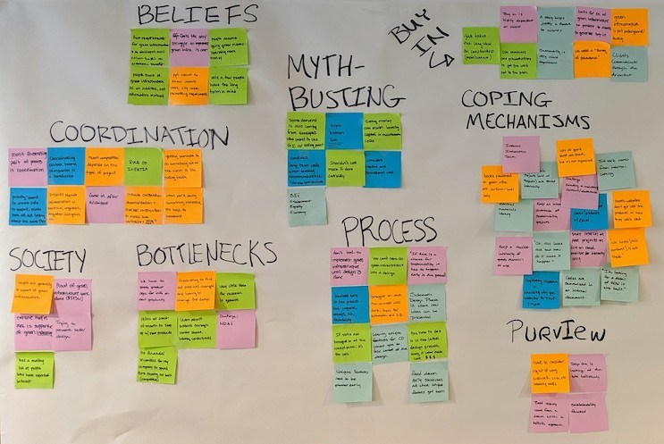
Synthesizing Data With Affinity Mapping
Affinity mapping:
A method for revealing underlying themes from large sets of qualitative data.
Notes:
Purpose: Define affinity mapping and its role in gaining customer insight.
Talking Points:
Affinity mapping comes from the world of UX, but it’s an approach that can be applied to other types of research and disciplines.
It’s useful for finding patterns and trends among lots of data, especially interview data.
Affinity mapping is one way to synthesize research.

Slide 68
Affinity Mapping: Step by Step
1
Each Post-it gets one data point: an observation, a quote, or a behavior.
2
Organize the data by the insights it suggests about the problem — not by solutions.
3
Give each grouping a title based on the theme it represents.
4
Map individually and discuss as a group.
Notes:
Purpose: Outline the process to properly affinity map.
Talking Points:
Here’s how affinity mapping works.

Slide 69
Affinity Mapping
Activity + Debrief Guide
Overview
Help students gain a better understanding the “why” and “how” of affinity mapping.
Activities
Guided walk-through (20 minutes): Show students how to affinity map and identify themes and behaviors. Students should be able to group insights from interviews, understand what is and isn’t a good data point, and identify why this process is important when developing an MVP.
Group/partner (15 minutes): Give students time to affinity map their interviews for their projects.

Slide 70
Affinity Mapping
20 minutes
Customize it!
Pays with credit card, doesn’t carry cash
Wants to order healthy sides
Doesn’t always tip for pickup service, only has cash
Doesn’t have time to talk on the phone
Doesn’t want them to call with issues or questions because she’s on the subway
Prefers to order from the same place but likes variety
Wants to have food ready based on the time estimate
Wants food ready to eat when they get home
Searches email for coupon codes if there’s time
Needs to pick up the food when she walks by the store
Always pays by card
Wants to order food on the subway
Difficult to eat healthy
Driving, doesn’t want to talk on the phone
Food ready with doorman when their kids get back from school
Promos for loyalty
Traffic varies, wants to order when 15 minutes from home
Picks up the food if it’s ready when he is
Tipping doesn’t seem so important
Salad
Notes:
Purpose: Walk through how to affinity map.
Talking Points:
Take a few minutes to look through the Post-its from the interview conducted for the food delivery service.
Let’s identify a few themes/behaviors together.
Teaching Tips:
Here are the interview notes for the exercise.
Display these on screen while students affinity map.
If on campus, have students write these on Post-its.
If remote, share this slide with students so they can copy/paste notes and affinity map digitally.
Customize It!
Feel free to use a different exercise. The key is to help students to understand the importance of businesses understanding their consumers.

Slide 71
Best Practice: Making Sense of the Groupings
< 3
data points
Too small Consider folding into other groupings.
> 10
data points
Too big Consider breaking into smaller groupings.
1
user
Too few Groupings should have data from at least two users.
Notes:
Purpose: Define how to create groupings when affinity mapping.
Talking Points:
When affinity mapping, you want to be conscious of these considerations as you create your groupings.
This data point system is good in helping contextualizing themes from your interviews.
Teaching Tips:
Be sure that students understand that the interviews they conducted during this class don’t provide enough data to use this benchmark system.
Provide an example of how you have used this method in your work as a PM.

Slide 72

Your Turn
15 minutes
Affinity map your interviews.
Then, determine whether the insights validate or disprove your hypothesis.
Remember:
Each Post-it should contain one observation, quote, or behavior.
Organize data by insights — don’t go into solution mode.
Notes:
Purpose: Give students an opportunity to affinity map their projects.
Talking Points:
Now that we’ve had a chance to practice affinity mapping mapping together, you’ll work with your groups to affinity map for your projects for the next 15 minutes.
Ask yourself about the themes or behaviors that come with each Post-it note.
As a note, validation usually happens after you have a complete map, but, for the sake of time, we will work with information we have.
Teaching Tips:
If on campus, walk around to each group to ensure that everybody is on track and answer any questions students have.
If remote, share this link to the slide specifically for affinity mapping.
Have students use the template below or a Miro board to organize their affinity map. (Keep in mind that there could be a learning curve when using Miro).
Remember to have students color-code their theme/behaviors.
Link to affinity mapping template: https://bit.ly/2JKmCVW (have students make a copy).
For remote classrooms:
Set up breakout rooms for student pairs/groups. Screenshot the slide and post it in the Slack channel before opening the rooms.
At the 60-second mark, send a message to all rooms: “Start to wrap up your discussions. Rooms will close in one minute!”
Move around from breakout room to breakout room to “walk around the classroom.”

Slide 73
Affinity Mapping Group Debrief
10 minutes
In your groups, review your hypothesis and evaluate how the themes/behaviors from your affinity map align. Questions to consider:
What are some insights you gained from affinity mapping?
How might these insights inform decisions you make about your product?
What was most challenging in organizationing this information?
Was there anything surprising?
Together, we will determine whether your project should pivot or proceed.
Notes:
Purpose: Give student a chance to reflect on the affinity mapping exercise.

Slide 74
For today, let’s ALL proceed with our original hypothesis.
Notes:
Purpose: Instruct student that they are going to continue to test their original hypothesis.
Talking Points:
After affinity mapping, some groups may notice that their hypotheses may need to pivot in a different direction based on their findings.
To maintain time constraints and maximize the workshop, each group will continue to test their original hypothesis rather than pivoting.
Teaching Tips:
Allow students to make small adjustments, but, if there are substantial changes, you need to tell them to keep the original hypothesis.

Slide 75
Choosing the Right MVP
Product Management Bootcamp
Products and Product Managers
Foundational Market Research
Analyzing Data
Choosing the Right MVP
Notes:
Duration: 60 minutes

Slide 76
What’s Coming
Define the methodologies used to evaluate customer experiences when picking the appropriate MVP.
‹#› | © 2021 General Assembly
Notes:
Purpose: Highlight the learning objectives that we’ll tackle in this section.

Slide 77
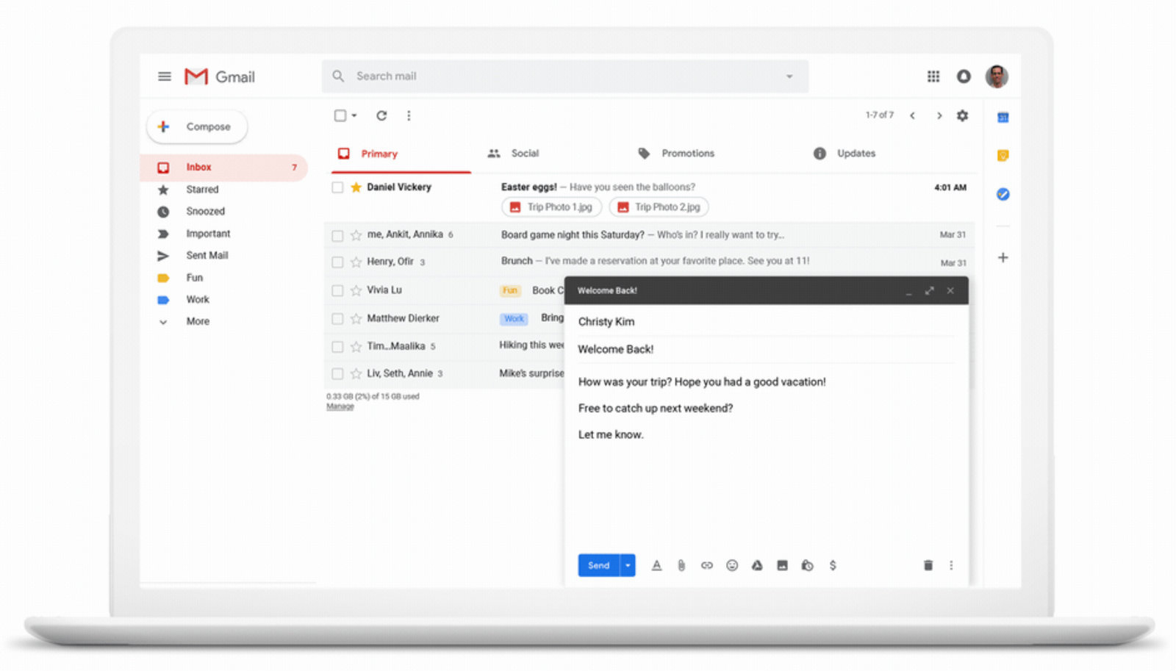
Features Inside of Features Inside of Features
5 minutes
Customize It!
Also a feature
Feature
Also a feature
Notes:
Purpose: Help students understand the importance of feature prioritization once they have made affinity maps.
Talking Points:
A product like Gmail has core features, such as sending an email, browsing the inbox, managing contacts, etc. But, within one of those features (e.g., sending an email), there are many smaller features (the compose email window, the compose button, the send button, etc.).
We just want to emphasize that features can be large or small depending on the overall product. Don’t think of features just as the big fancy things.

Slide 78
Features and Prioritization
5 minutes
What factors should always be considered when determining the priority of a feature?
Notes:
Purpose: Connect the importance of features to customer satisfaction.
Talking Points:
Now that we have made affinity maps from our interviews and collected insights, let’s talk about features.
We know that we need to prioritize features for an MVP based on assumptions we need to validate. But what other factors should we be thinking about?
Answer: Customer value and level of effort.

Slide 79

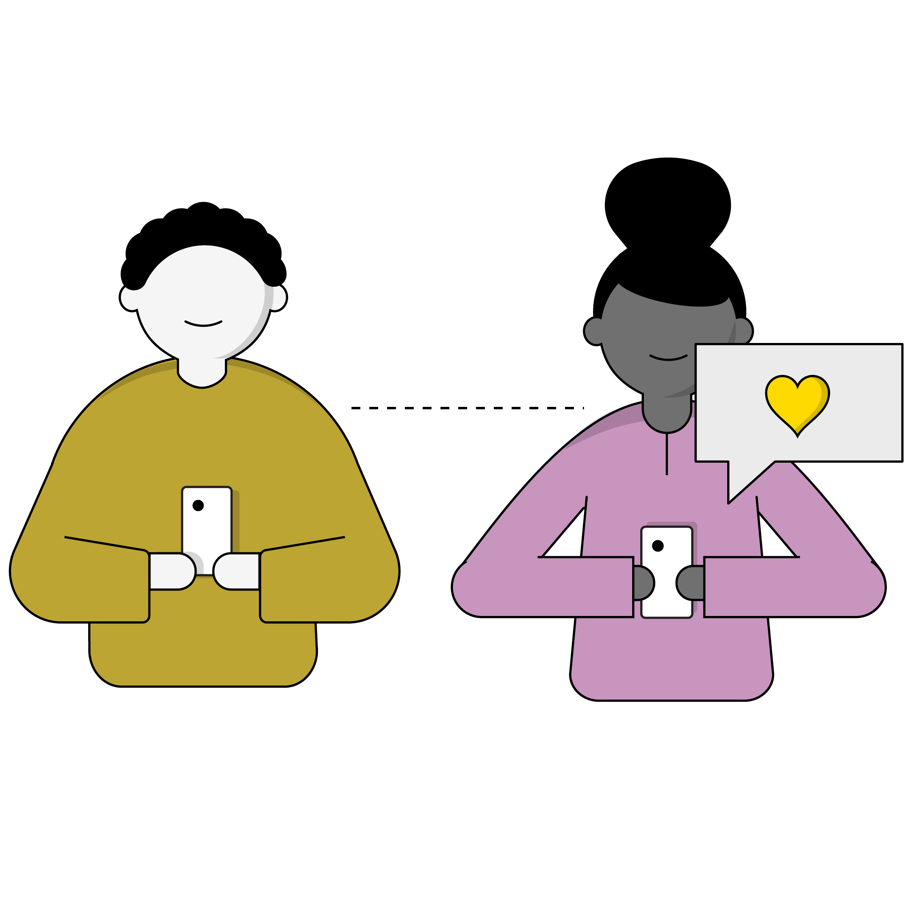

Features and Prioritization
Level of Effort
Customer Value
Business Value
How difficult will it be to build?
How much more satisfied will our customers be?
How much will it help our business?
Notes:
Purpose: Learn how to gauge the importance of a feature.
Talking Points:
Prioritization can be highly subjective. Ultimately, there are a few major factors that influence whether or not something should be prioritized:
Customer value: How much more satisfied will our customers be with our product if they are given access to this feature?
Level of effort (LoE): What resources are required to build this feature?
Business value: How much will it help the business?
LoE should factor in everything, including the time needed to write the requirements, create designs, complete engineering, test, and roll out the feature to users.
The product manager needs to be able to clearly articulate the criteria used for prioritization to the product team and stakeholders.
Product managers frequently have to inform stakeholders that their requests for the product will not be implemented. Having a clear prioritization method allows others to understand how decisions are made and builds trust that decisions are made fairly, logically, and in the best interest of the customer and the organization.

Slide 80
From Assumptions to MVP
Assumptions
Hypotheses
Features
MVP
Notes:
Purpose: Give students context into how MVPs fit into the product development process.
Talking Points:
To have the fastest (and usually cheapest) minimum viable product (MVP) iterations, the number of features should be limited to those that are absolutely required to test hypotheses from the most important risks, assumptions, and customer problems.
Usually, it’s better to test one key hypothesis this week rather than two or three hypotheses next week.
Be ruthless in limiting the number of features in prototypes and MVPs.

Slide 81

In Your Own Words…
5 minutes
What Is an MVP?
Notes:
Purpose: Give students a chance to share their understanding of MVPs.
Talking Points:
Quick popcorn discussion: Who knows what an MVP is and can share a definition?
For remote classrooms:
Instruct students to come off mute to share their responses.

Slide 82
Minimum
Viable
Product
The least amount of work you can do to learn the most about something.
Notes:
Talking Points:
Here’s how we define an MVP: It’s all about learning as quickly as possible.

Slide 83
The smallest possible product that has three critical characteristics: People choose to use it or buy it; people can figure out how to use it; and we can deliver it when we need it with the resources available.
— Marty Cagan
Founding partner, Silicon Valley Product Group
Notes:
Talking Points:
Another important point about MVPs: They’re buyable and usable.
Whereas prototypes are just wireframes or sketches, MVPs are an actual product you can put into market that can be used.
Marty Cagan is the founding partner of the Silicon Valley Product Group.

Slide 84

Why MVP?
Reduce risk and maximize success.
Gather feedback on our assumptions faster.
Reduce overhead.
Make more measurable progress.
Notes:
Purpose: Give learners an understanding why MVPs are important.
Talking Points:
Reduce risk and maximize success.
By only building the smallest possible product, we’re minimizing our upfront investment and giving ourselves room to change course if needed.
Get faster feedback.
By releasing a smaller product, we’ll get real feedback from customers much faster than if we had to develop a product with more features.
This allows us to quickly respond to feedback — positive or negative — and ensure we’re building the right product.
Reduce overhead.
Smaller releases requires less testing, training, and other efforts surrounding the release of a product or new features.
Make measurable progress.
Get quantitative insight on the benefit our product is creating.
Smaller product means faster releases, which makes real results faster.

Slide 85
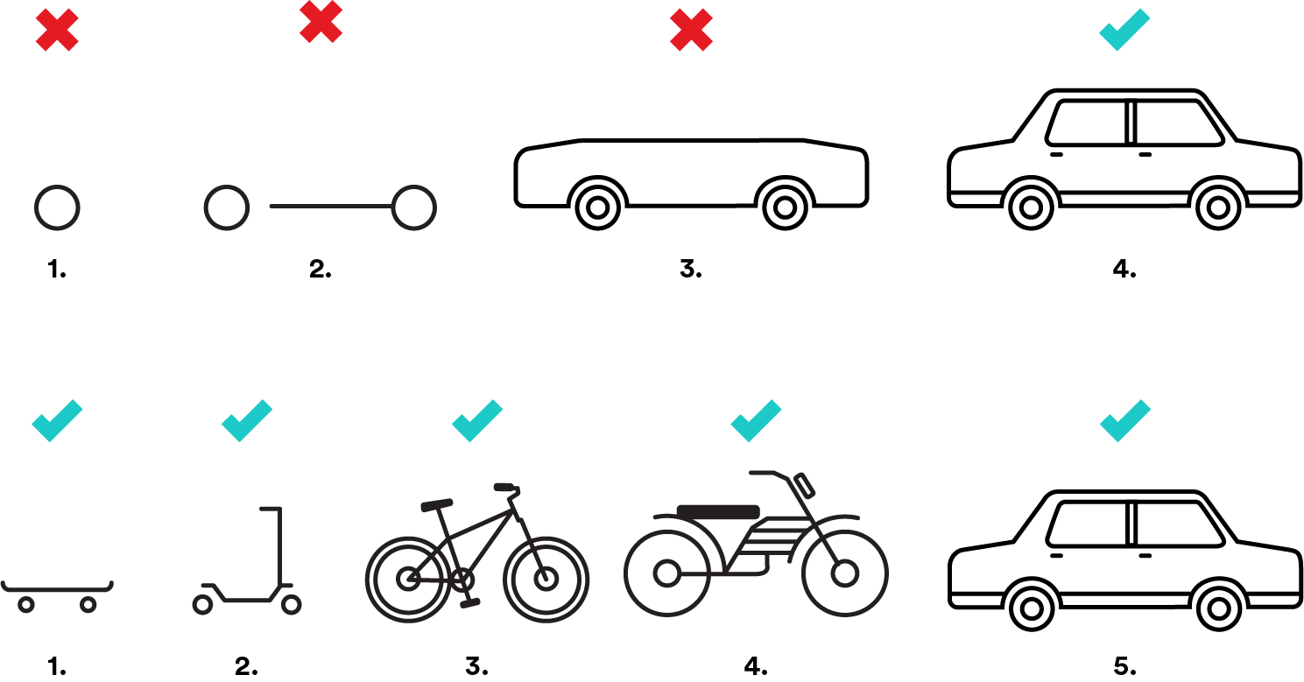
How We MVP
Not like this…
…like this.
Notes:
Purpose: Understand the goals of an MVP.
Talking Points:
Here’s what we mean when we say MVPs can be bought and used.
When thinking about the an MVP, it is a product that can be used at different phases of the development process.
This example here shows that, when creating an MVP, we need to be testing and adding features while we’re developing. This is instead of producing a finished product without testing features to see what works and what doesn’t.

Slide 86
Consider What to Include in an MVP
Now
What functionality do customers need to solve their problems?
What assumptions do we need to validate immediately?
Later
What functionality is nice to have — but not critical — in solving the problem?
What assumptions are less risky or better understood already?
Notes:
Purpose: Outline what is an isn’t important to include in an MVP.
Talking Points:
To limit the features in an MVP, you can categorize features into “now” (goes in the MVP) or “later” (goes in a future iteration).

Slide 87
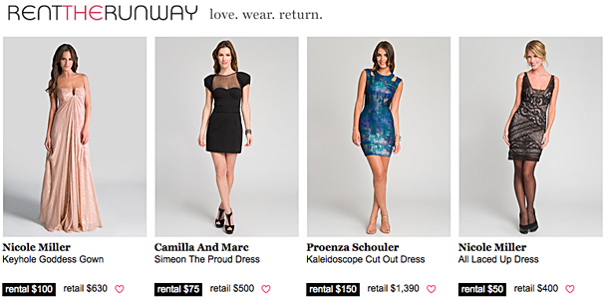
Concierge MVP
Customize It!
Used to demonstrate a hard concept.
Can be pieced together without the technology being completely in place.
Notes:
Source: https://hbr.org/2013/09/building-a-minimum-viable-prod
Talking Points:
We’ll look at a few forms that MVPs can take so you can understand the idea of getting something to market quickly in order to learn.
The first is a concierge MVP.
In this, users know it’s not an automated system: It’s being done manually, much like a concierge in a hotel.
Rent the Runway tested its online dress rental business model by providing an in-person service to college students that let them try the dress on before renting it. This validated its riskiest hypothesis that women would rent dresses and served as a great concierge MVP that put the business in front of customers to get their feedback.

Slide 88

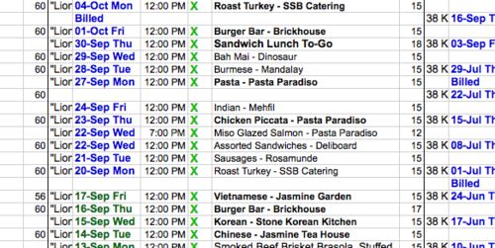
Wizard of Oz MVP
Customize It!
Everything appears to be real to the customer, but on the back-end, it is manual.
Tests riskiest assumptions before spend money on technology, inventory, warehousing, etc.
Notes:
Source: https://thenextweb.com/dd/2014/11/12/15-ways-test-minimum-viable-product/
Talking Points:
Another MVP type is the Wizard of Oz, in which the user sees everything working normally but everything is actually manual on the back-end.
Arram Sabeti, founder of ZeroCater, started with a giant spreadsheet, which he used to keep track of companies and caterers with which he could connect. Zappos began the same way, with its founder Nick Swinmurn putting up photos of shoes from local shoe stores on a website to gauge demand for an online store.
This approach also allows for greater interaction with customers at this crucial stage when you’re designing the product. Observing actual customers firsthand is always more useful than a hypothetical customer survey, and it’s the fastest way to discover whether or not a product solves a real-world customer problem.

Slide 89

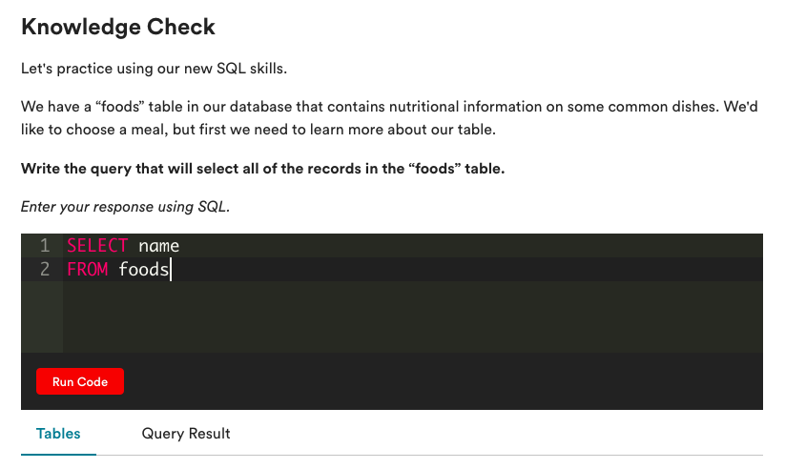
Single-Feature MVP
Customize It!
Focus on the key feature(s) that are most valuable to users or the riskiest assumptions to test.
Notes:
Talking Points:
Another form of MVP focuses on developing the 1–2 most important features first before building out the bells and whistles.
A good example of this comes right here at GA. Our myGA learning platform is used for almost all of our courses, including coding and data courses. However, the platform didn’t have functionality that allowed students to write code directly on myGA — they’d have to navigate to another site or an editing tool to actually write the code they’re being taught in the lesson.
As an MVP, we built a code editor that allowed students to write basic SQL and Python code directly in the platform. It was an MVP because it only supports two of the languages we teach (not JavaScript, HTML, CSS, Ruby, etc.) and is limited to writing code and checking if it’s correct, not building out an entire application. This limited feature set allows us to solve the user need of writing code directly in myGA and learn about how students use that feature.

Slide 90
Consider what to Include in an MVP
You’re building an MVP for Spotify and have identified two assumptions you want to validate:
I want to stream unlimited music without breaking my budget.
I want to stream music on my phone, but I don’t want to use all of my mobile data.
Review the list of features and classify them as “Now” (included in the MVP) or “Later” (included in a future rollout).
Features:
Search for music
Create playlists
Share playlists
Post your playlist to Facebook
Radio
Mobile offline mode
Video ads
Activity feed
Private sessions
Stations
Recommended songs
Ad-free premium service
Notes:
Purpose: A short exercise to describe feature prioritization.
Talking Points:
Let’s practice this by imagining that we’re building an MVP at Spotify. We’ve identified the assumptions we need to test and a list of potential features that could solve these needs.
But how do we know what to build first? Let’s categorize the features into “Now” and “Later.”
Clarification on some of these features:
Search for music
Create playlists
Share playlists
Post your playlist to Facebook
Radio (similar to Pandora)
Mobile offline mode
Video ads
Activity feed
Private sessions
Stations (save a radio station for a certain artist or song)
Recommended songs
Ad-free premium service

Slide 91
How do we know whether or not an MVP works?
Notes:
Purpose: Let students know that there are a variety of ways track the success of an MVP.
Talking Points:
It’s hard to generalize on this one. It depends on what assumptions you hope to validate with your MVP. A better way to think about it is “How will I know my MVP was successful?” That could be simply validating interest, your target customer, which features are most important, or whether a user would even use a new feature or service.

Slide 92

Plan an MVP
10 minutes
With your group, determine which feature would be required for your MVP.
Based on those features, which MVP makes sense for your project?
Notes:
Purpose: Give students a chance to gauge their understanding of the different MVP types.
For remote classrooms:
Instruct students to come off mute to share their responses.

Slide 93
Wrapping Up
Product Management Bootcamp
Notes:
Duration: 15 minutes

Slide 94
Finish That Sentence
“Something that really got me thinking is...”
“The best thing I got out of today is…”
What are your biggest takeaways from today?
Grab two Post-its and write out one statement for each.
“I rediscovered…”
“I still want to learn about…”
“I was surprised that…”
Notes:
Purpose: Debrief the workshop.
Talking Points:
On your own, spend a few moments to think about today’s workshop. What did you take away? What would you like to learn more about? How can you use this new information?
Complete one of the following sentences, then share at your table:
My favorite case study was…
The best thing I got out of today is…
When I get back, I plan to…
I’m excited to learn more about…
Teaching Tips:
Give participants a few minutes, then have them share out (either at tables or the whole class, depending on time).

Slide 95
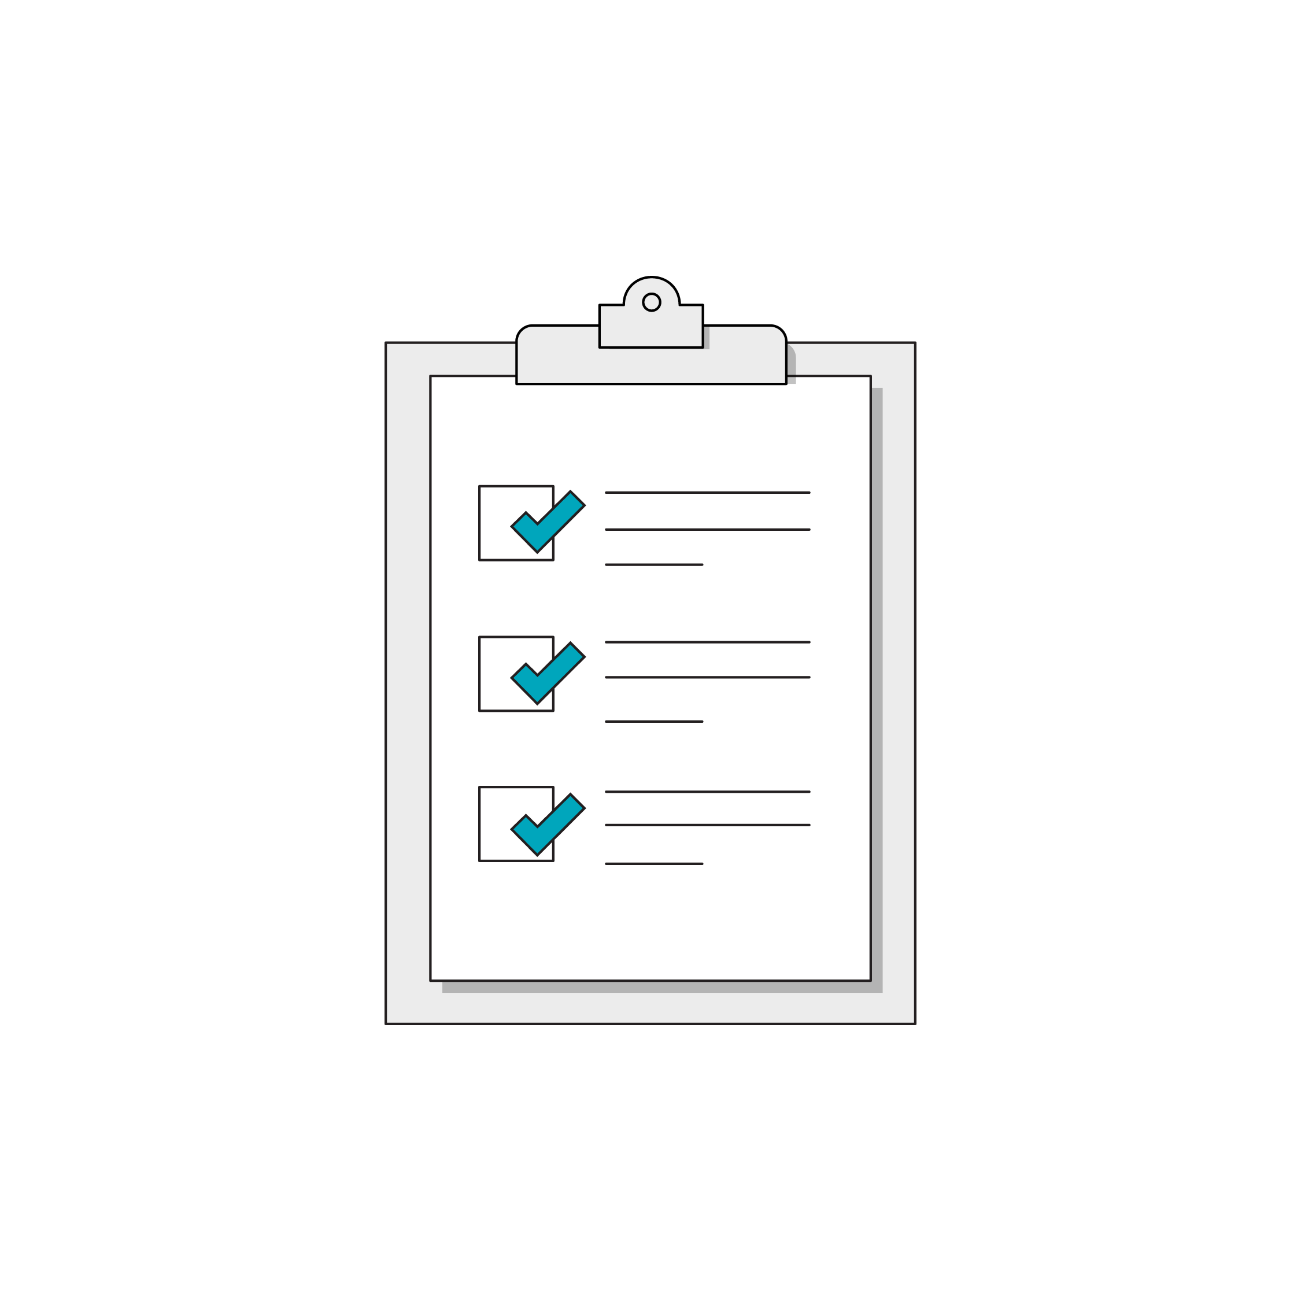
We Want Your Feedback!
A survey will be sent to you within 24 hours. Please keep an eye out for it and let us know what you liked about this class and what we can improve.
Thank you!
‹#› | © 2020 General Assembly

Slide 96
Questions?

Slide 97
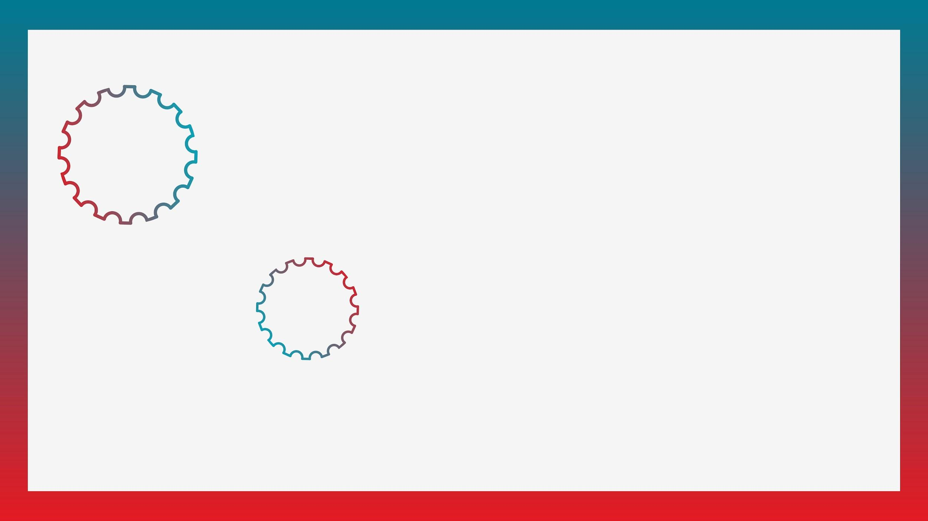

Take Another Workshop
With [Name]!
Customize It!
Sign up at ga.co/[YourName]
Notes:
Customize It!
Replace all bracketed “[ ]” text with your name (in the yellow highlighted text) and in the URL in the red box (i.e., ga.co/YourName).
Reach out to your GA point of contact to have a ga.co short link created for you.
Right-click on circle labeled “Your photo” and select “Replace image” > “Upload from computer.” Select your desired photo from your computer and click “Open.”

Slide 98
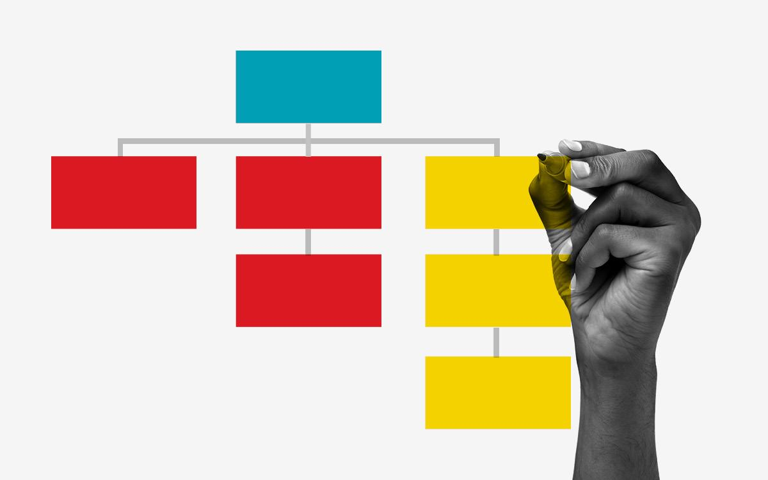
Workshops @ GA
Check out our business workshops in:
Project Management
Product Management
Agile and Scrum
Presentation Skills
Public Speaking
Personal Brand
Or explore all of our upcoming workshops: ga.co/workshops
‹#› | © 2020 General Assembly

Slide 99
Take Your Next Step with GA
 | Product Management
Format | Part-time/evenings
Next Course | <DATES>
Outcome | Learn to launch viable, market-ready products and features that solve real problems for your customers.
Tuition | $3,950*
*Financing options available.
‹#› | © 2020 General Assembly

Slide 100

Fund Your Future
We offer a range of student financing and payment options to make your path to education easy, including:
Installment plans
Loans
Scholarships
Income Share Agreements
…and more!
To explore all of our financing options, visit ga.co/financing.
‹#› | © 2020 General Assembly
‹#› | © 2020 General Assembly

Slide 101



Let’s Keep In Touch!
Curious about our courses? Speak to our admissions team and they’ll help you find the right path!
Admissions: ga.co/FindYourCourse
Want to experience GA beyond the classroom?
Events: ga.co/events
Follow us!
@generalassembly
@GA
@generalassembly
‹#› | © 2020 General Assembly

